Slide 1
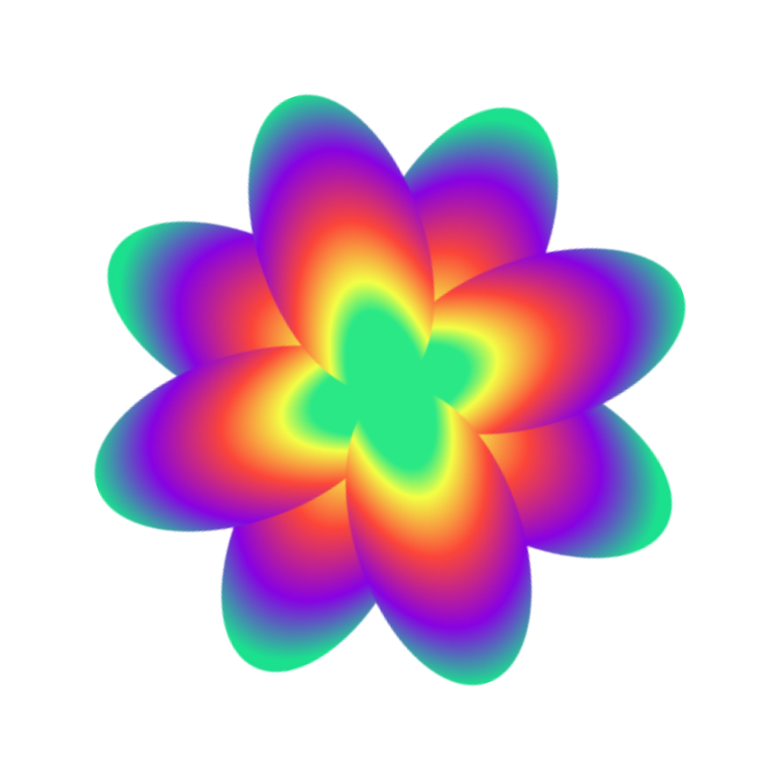





Spotify Trends: A Data-Driven Exploration
Notes:
Shelomith

Slide 2



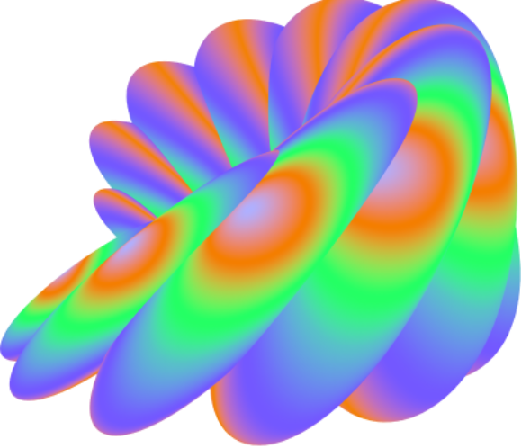
Table of Contents
01
Introduction
02
Dataset Overview
03
Distribution of Features
04
Visualizations

Slide 3
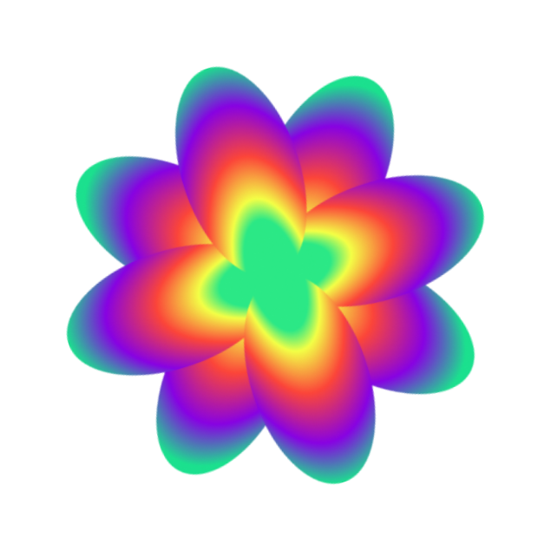



Introduction
Objective: This project explores 2,000 Spotify songs to find meaningful patterns in features like popularity, tempo, and danceability. The goal is to better understand what shapes a listener's experience and what makes certain songs stand out.
Why does this matter? Songs are everywhere in our lives—at parties, in our headphones, or even as background noise. By analyzing their features, we can uncover trends in music that might otherwise go unnoticed, like why certain genres are more energetic or which characteristics drive a song’s success.
Notes:
Charlie

Slide 4
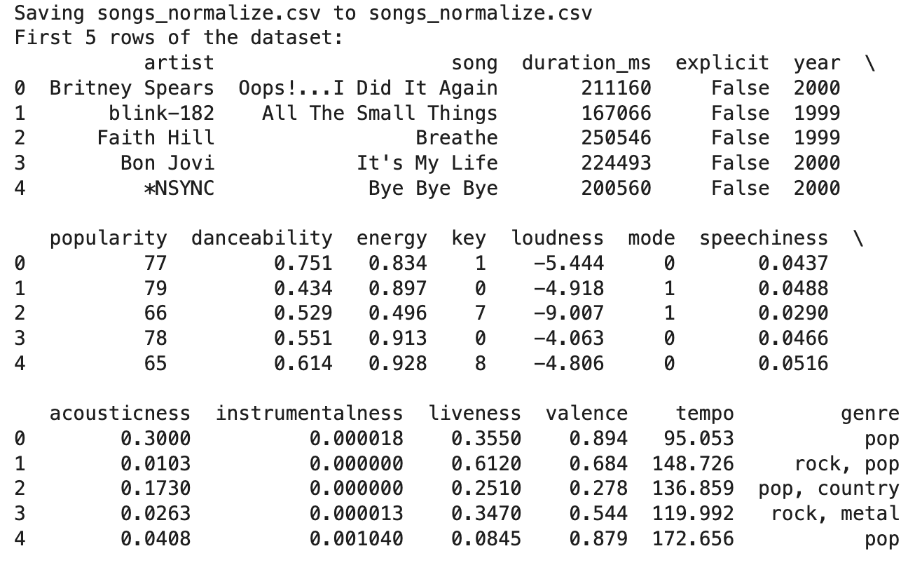
Dataset Overview
Size: 2,000 songs
Columns: 18 features
Key Attributes:
Artist and Song: Identifies each song uniquely.
Duration (ms): ength of each song in milliseconds.
Explicit: Boolean flag indicating if a song contains explicit lyrics.
Year: Release year of the song.
Popularity: A score representing the song's popularity (higher is more popular).
Notes:
Lilian

Slide 5


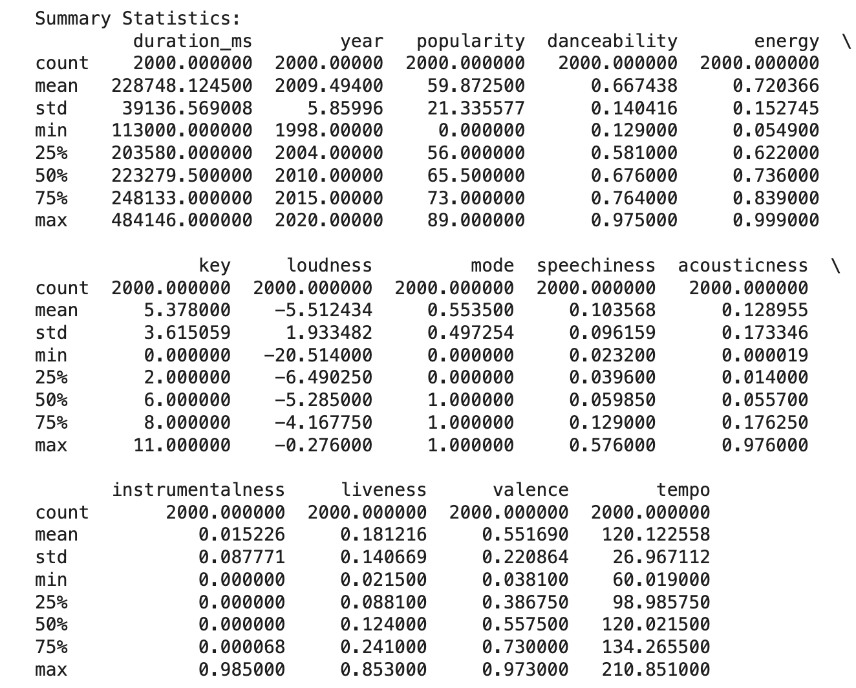
Step 1: Understanding Our Data
We began by importing the dataset, songs_normalize.csv, onto our Google Colab environment. This dataset contains detailed information on 2,000 Spotify songs, including their characteristics like popularity, tempo, danceability, and genre.
We performed a data validation check, confirming:
There are 18 columns representing various features of the songs, such as energy, explicitness, and valence.
The dataset is complete, with no missing values or inconsistencies.
Quick Summary Statistics:
Popularity: Ranges from 0 to 89.
Tempo: Ranges from 60 BPM (slow) to 210 BPM (fast).
Danceability: Averages around 0.67 on a 0–1 scale.
Notes:
Anika

Slide 6
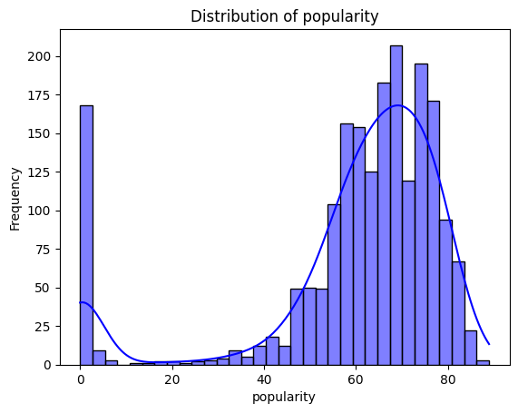
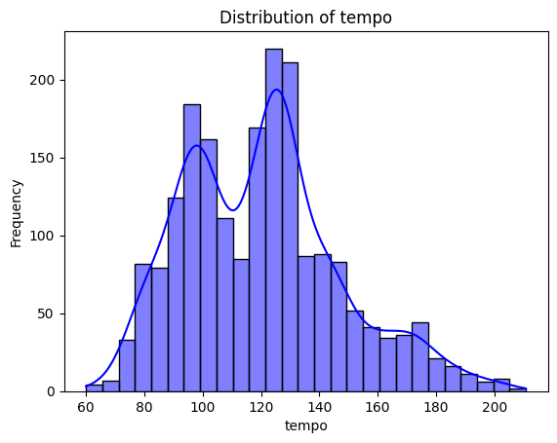
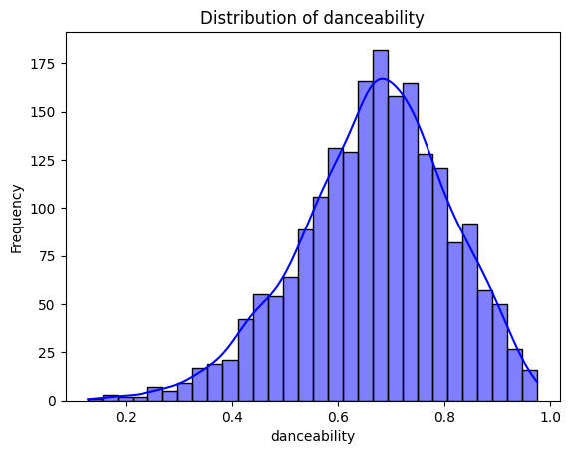
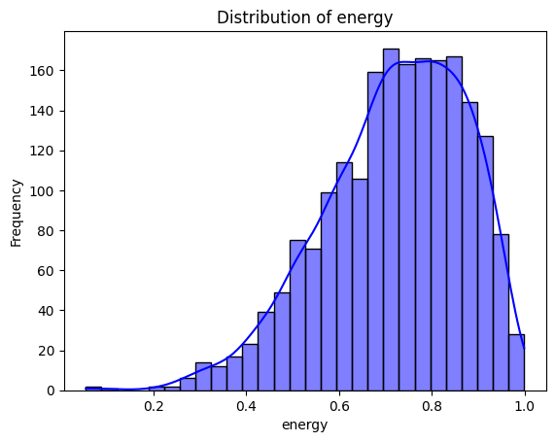
Exploratory Analysis
Step 2: Creating Our Visualisations
Most songs are moderately popular, with some very low-popularity outliers.
Tempo peaks at 120–140 BPM for upbeat tracks and 60–80 BPM for slower songs.
Most tracks are highly danceable, clustering around 0.6–0.8.
Songs tend to be energetic, with scores often between 0.6–0.8.
Notes:
Brian: We wanted to understand how different features, like popularity or tempo, are spread across the songs. By examining distributions, we could identify patterns that reflect listener preferences and the types of songs that dominate Spotify.
Most songs have moderate popularity (50–80), with a notable spike at 0, possibly reflecting new or niche tracks. The dataset primarily consists of well-received songs, with a small proportion of outliers.
Songs peak around 120–140 BPM (typical of upbeat tracks) and 60–80 BPM (slower songs). The dataset reflects a mix of fast-paced and slower tracks, catering to diverse listener preferences.
The dataset favors danceable songs, aligning with listener engagement trends.
The dataset emphasizes energetic songs, likely representing popular and dynamic genres.

Slide 7
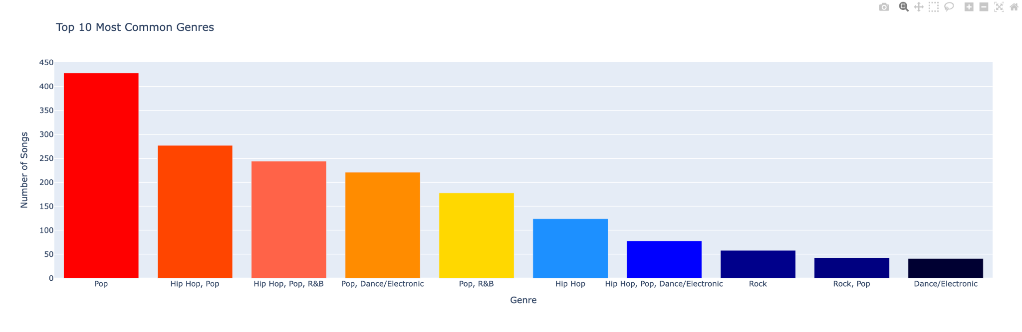
Top 10 Genres
Why Genres Matter: Help us understand music trends and listener preferences.
Key Insights:
Pop Dominates - Over 400 songs, highlighting its massive appeal.
Genre Blends - Hybrids like “Hip Hop, Pop” and “Pop, R&B” reflect the popularity of fusion styles.
Hip-Hop's Influence -Appears frequently, both on its own and in hybrid genres.
Conclusion: Pop and Rock dominate, showcasing mainstream preferences.
Notes:
Charlie:
This bar chart illustrates the top 10 most common genres in the dataset, ranked by frequency. Pop leads by a wide margin, with over 400 songs, showcasing its massive mainstream appeal.
One interesting trend is the prevalence of hybrid genres. For instance, combinations like 'Hip Hop, Pop' and 'Pop, R&B' reflect the blending of styles that has become a defining feature of modern music.
Hip-Hop also stands out, appearing frequently both as a standalone genre and within combinations. This shows its significant role in shaping other genres and its widespread impact on contemporary music.

Slide 8
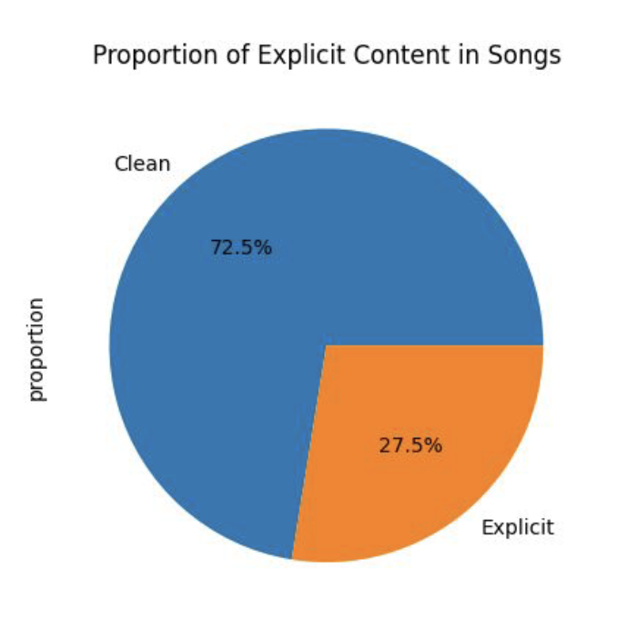
Proportion of Explicit Content
Why It Matters: Tracks explicit vs. clean songs in top hits from 2000–2019, reflecting audience preferences and artist trends.
Observations:
72.5% Clean: Most top hits avoid explicit content, showing accessibility.
Pop Genre: Not all Pop songs contain explicit content (e.g., Britney Spears' "Oops!... I Did It Again").
27.5% Explicit: Explicit songs dominate certain genres like Hip-Hop.
Real Life Example: Helps platforms like Spotify refine content recommendations for family-friendly audiences or create explicit-content filters.
Notes:
Emma
This dataset includes top hits from 2000 to 2019, allowing us to explore how explicit content is distributed across popular music. From this chart, we see that 72.5% of songs are clean, catering to broader audiences, while 27.5% are explicit, often concentrated in genres like Hip-Hop.
Interestingly, not all Pop songs have explicit content, even though Pop dominates mainstream music. This reinforces the versatility of Pop as a genre, appealing to both family-friendly and mature audiences.

Slide 9
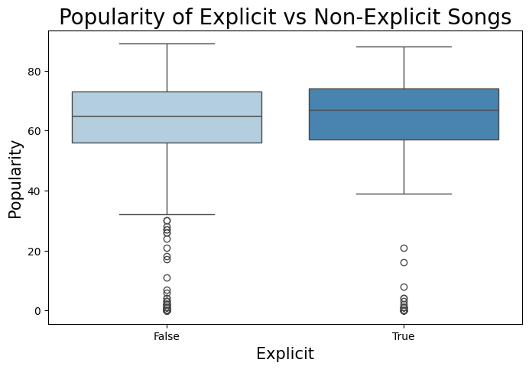
Popularity of Explicit vs. Non-Explicit Songs
Observations:
Median Popularity: Both explicit and non-explicit songs have comparable medians.
Non-Explicit Songs: Show a broader popularity range, spanning mainstream hits and niche tracks.
Explicit Songs: Have tighter popularity distributions but with some low-performing outliers.
Conclusions:
Explicit content doesn’t guarantee higher or lower popularity but may reflect genre-specific trends.
Notes:
Emma
Similarly, from the box plot, we see that the median popularity is nearly the same for both explicit and non-explicit songs. This suggests that explicit lyrics alone do not determine whether a song becomes a hit.
However, non-explicit songs show a broader popularity range, capturing both major hits and less mainstream tracks.
On the other hand, explicit songs have a tighter distribution, indicating more consistency in their popularity.

Slide 10


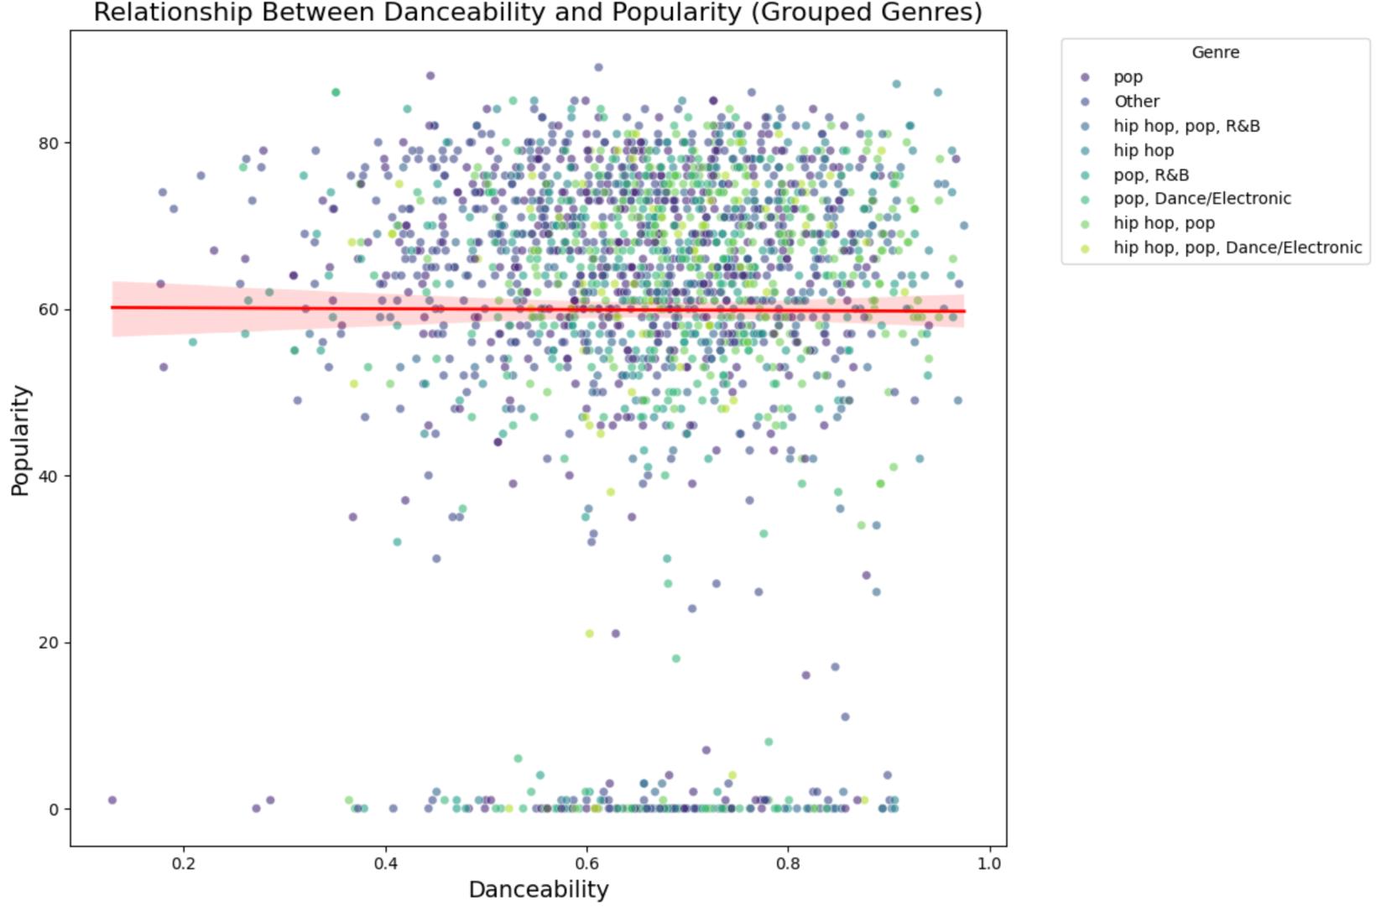
Relationship between Popularity and Danceability
Genre Consolidation: Less common genres (<75 songs) grouped as "Others" to declutter the visualization.
Genre Clusters:
Pop & Dance/Electronic is expected to have high danceability but show varied popularity levels.
Hip-Hop & R&B is similar danceability levels but inconsistent popularity.
Mixed Genres - Genres like "Pop, Hip-Hop, R&B" or "Hip-Hop, Pop, Dance/Electronic" reflect hybrid influences, showing broad danceability but still no strong correlation with popularity.
Notes:
Nicole
To better understand this relationship, we grouped less common genres into an 'Others' category, which allows us to focus on the more prominent genres like Pop and Hip-Hop.
Observations:
Pop & Dance/Electronic: These genres, often associated with danceable music, exhibit high danceability values. However, their popularity varies significantly, showing that even within dance-heavy genres, danceability alone doesn't guarantee success.
Hip-Hop & R&B: Songs in these genres show similar danceability levels, but their popularity is highly inconsistent, highlighting the diverse factors at play in listener engagement.
So, a song’s popularity is a combination of genre-specific characteristics, artist reputation, and many other factors.

Slide 11
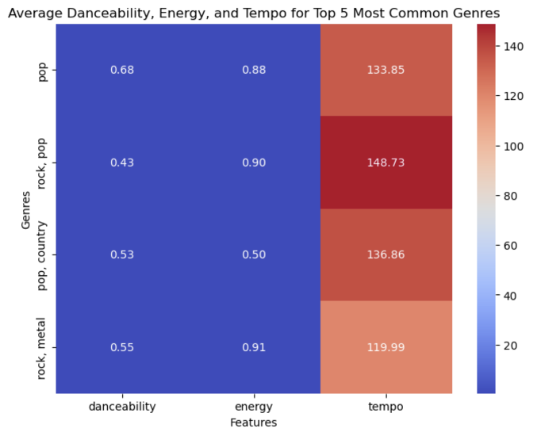
Danceability, Energy, & Tempo of Top Music Genres
This heat map displays the average danceability, energy, and tempo for the most popular genres of music on a relative scale
Warmer colors represent larger values; cooler colors represent smaller values
Danceability - how easy it is to dance to a song (based on rhythm, beat, etc.)
Pop is the most danceable genre
Energy - volume, intensity
Rock increases the energy features of music (rock, pop and rock, metal)
Tempo - speed or pace
Rock, pop has the fastest tempo
Pop appears to be the most balanced genre; whereas rock is more extreme due to fast tempo but low danceability
Notes:
Shelomith
Next, we’re going to explore features such as danceability, energy, and tempo for the most popular genres of music in our dataset, which are: (1) pop, (2) rock, pop, (3), pop, country, and (4) rock, metal.
This heat map displays the values on a relative scale, with warmer colors representing higher values and cooler colors representing lower values.
First, danceability describes how easy it is to dance to a song, based on other factors such as rhythm and beat.
Next, we have energy, which refers to the volume and overall intensity of a song.
Finally, tempo measures the speed or pace of a song
Overall, we can conclude that pop appears to be the most well-rounded genre, scoring median values across all features in danceability, energy, and tempo. On the other hand, rock is more specialized, exhibiting high tempo and high energy but low danceability

Slide 12
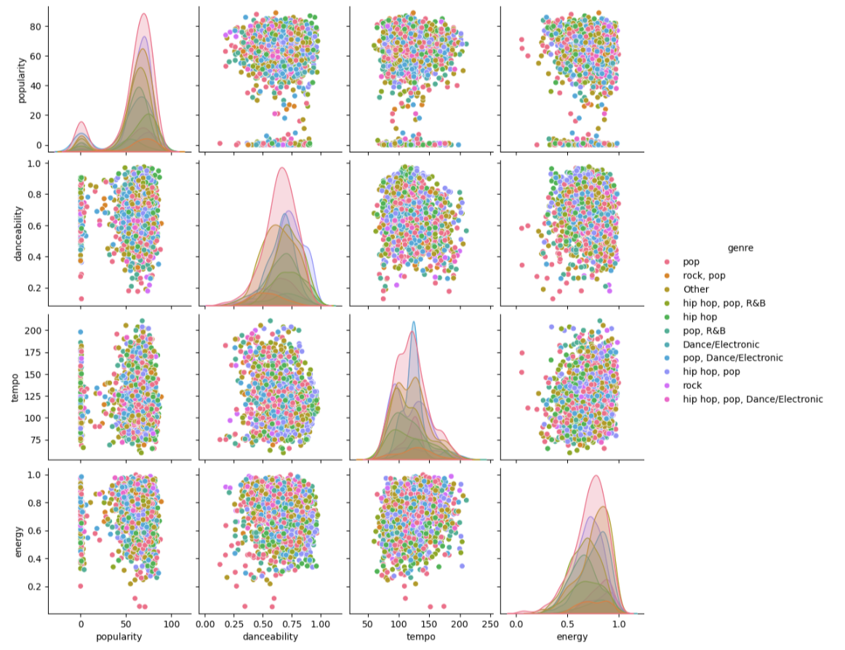
Relationship between Key Features
Observations:
Pop seems balanced across all features, reinforcing mainstream appeal.
Rock has high energy but lower danceability, with moderate popularity.
Hip-Hop has a strong presence in danceability but more variability in energy and tempo.
Hybrid genres (e.g., Hip Hop, Pop) show diverse feature combinations.
Conclusions:
Features like energy and tempo reflect genre-specific trends while blending adds complexity.
Notes:
Lilian
This pair plot compares key features—popularity, danceability, tempo, and energy—across different genres. Each point represents a song, color-coded by its genre.
Looking at the individual distributions along the diagonal, we see that Pop stands out for its balance across all features, which likely explains its dominance in mainstream music. Rock, on the other hand, shows high energy but lower danceability, aligning with its intense, performance-driven style. Hip-Hop, known for its rhythmic emphasis, performs well in danceability but exhibits more variability in tempo and energy.

Slide 13
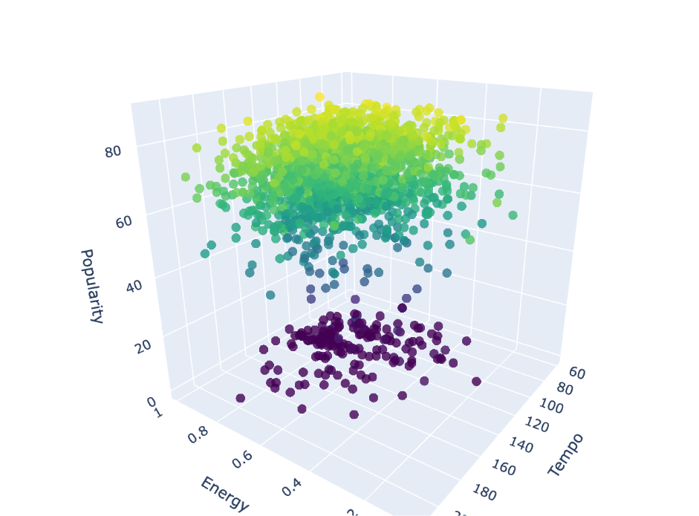
Relationship between Energy, Tempo, and Popularity
Observations:
No clear relationship: The data shows no distinct correlation between popularity, energy, and tempo.
Two groups: Purple points represent less popular songs, while green/blue points are highly popular.
Negative trend: Lower tempo often corresponds to higher energy levels.
Conclusion:
Popularity does not depend directly on energy or tempo but may reflect other factors.
Notes:
Kevin
3D allows us to visualize the clusters and distributions in a more tangible way, like how the purple and green/blue points form distinct zones.
Let’s take a closer look at the relationship between popularity, energy, and tempo. The data shows a clear divide:
Purple points, clustered at the lower end of the popularity scale, represent less popular songs.
Meanwhile, green and blue points, with similar energy and tempo values, are songs that hold much higher popularity.
This suggests that popularity isn’t directly tied to energy or tempo. However, the graph does reveal a loosely negative correlation between energy and tempo, where lower-tempo songs tend to have higher energy levels—possibly reflecting distinct musical styles or genres.

Slide 14
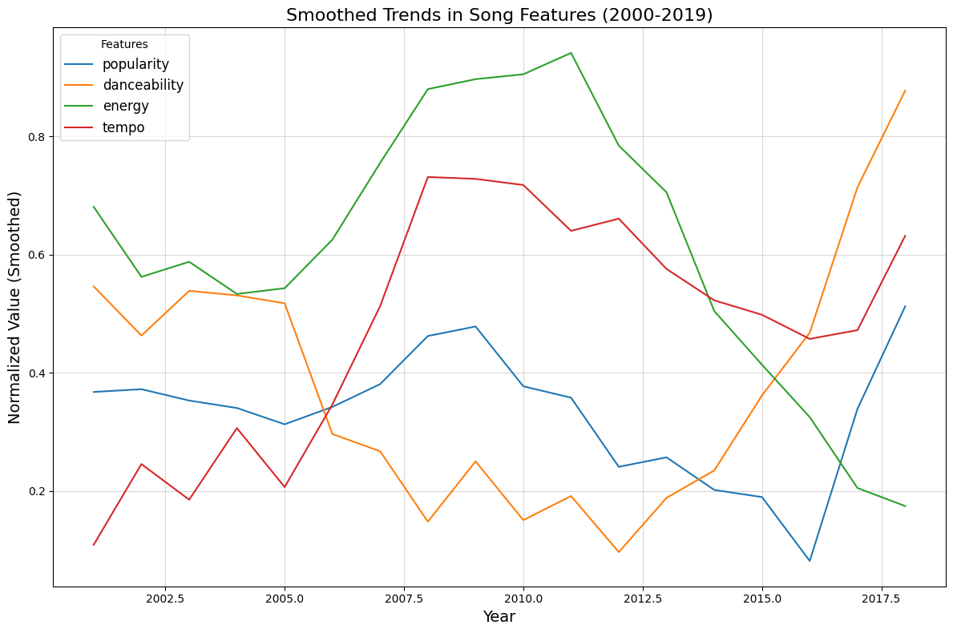
Music Trends Over Time
Observations:
Danceability shows increased sharply after 2015, signaling a rise in upbeat, rhythm-heavy music.
Energy peaked mid-2010s, then declined, hinting at a shift toward mellow genres.
Tempo fluctuates without clear trends, reflecting stylistic experimentation.
Popularity is consistently steady, showing sustained listener engagement.
Conclusions:
Rising danceability aligns with trends in global pop and EDM.
Declining energy suggests diversification into mellow/ slower genres.
Notes:
Anika
From our analysis of song features over the past two decades, we observed several interesting trends:
First, danceability has increased sharply since 2015, reflecting a growing preference for upbeat, rhythm-heavy music, driven by global pop and EDM. On the other hand, energy peaked in the mid-2010s but has since declined, possibly indicating a shift toward more mellow or introspective genres.
Tempo, which influences the pace of songs, fluctuates without a clear long-term trend, showing consistent stylistic experimentation by artists. Finally, popularity has remained steady throughout, indicating that songs continue to resonate with audiences despite evolving trends.

Slide 15




Thank you!
Credit | mage: Unsplash
Notes:
Shelomith

